Slide 1
Updates
Optical SCA poster ready for HOST, Presentation & poster ready for DAC
Finished survey paper
Compiler-based software hardening
Made a step-by-step plan
Working on deriving compiler-friendly parameters from layout-level laser modeling
Frontside laser modeling attempt on layout, finished IR simulations with laser-induced ΔT
Investigations on GCC compiler plug-in, hardening rules, etc. Found 2 hardening database
RTL-SoFI & validation work with Pantha
Got AES software assembly codes, working on simulating with Arianne core
Status: bit-flips succeeded on Instruction Registers: security properties about data integrity + instruction manipulation
Working on laser timing control
Full RISC-V ISA core (Arianne)

Slide 2
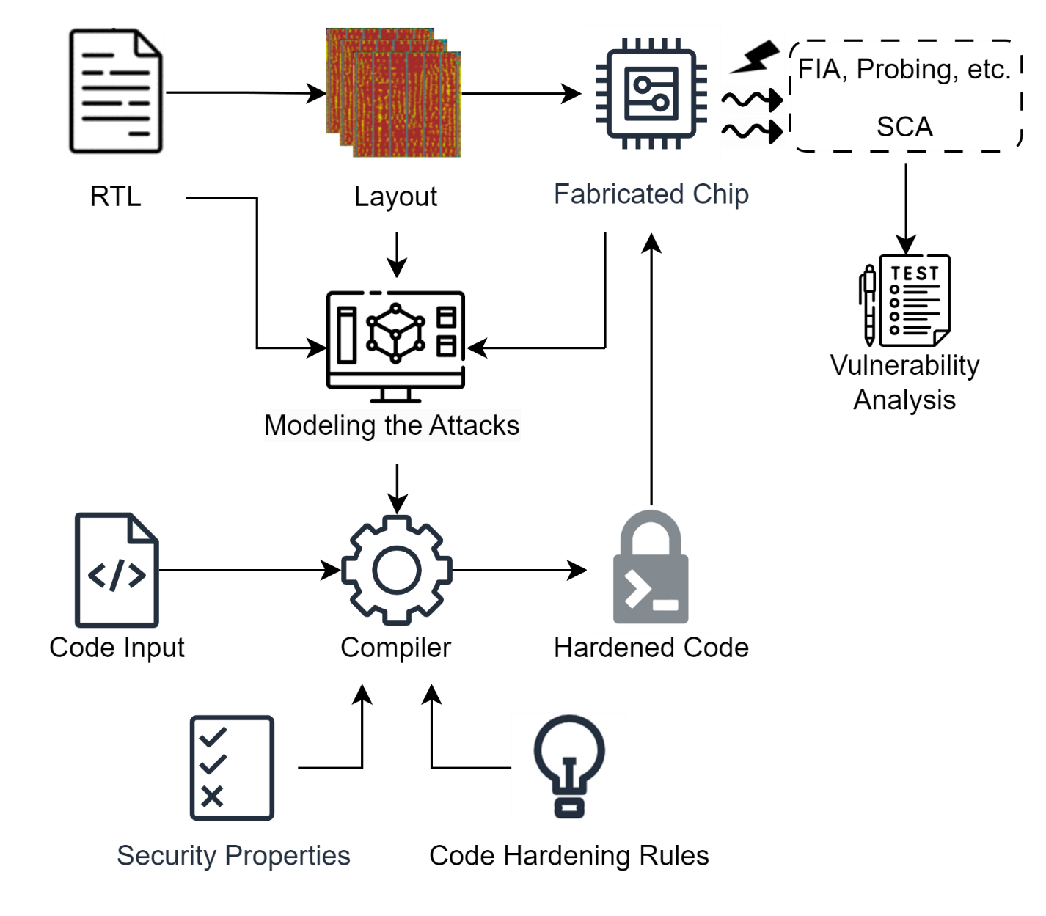
Project Tasks
Phase 1: focus on fault-injections
Task 1: fault injection modeling
Modeling from layout info
Modeling from post-silicon findings
Task 2: compiler development
Test case and security properties
Modeling-compiler interact
Hardening rules database
Code encapsulation, and proper documentations
Task 3: evaluation
Vulnerability analysis of original and hardened code
Software Hardening against Physical Attacks at Compilation

Slide 3
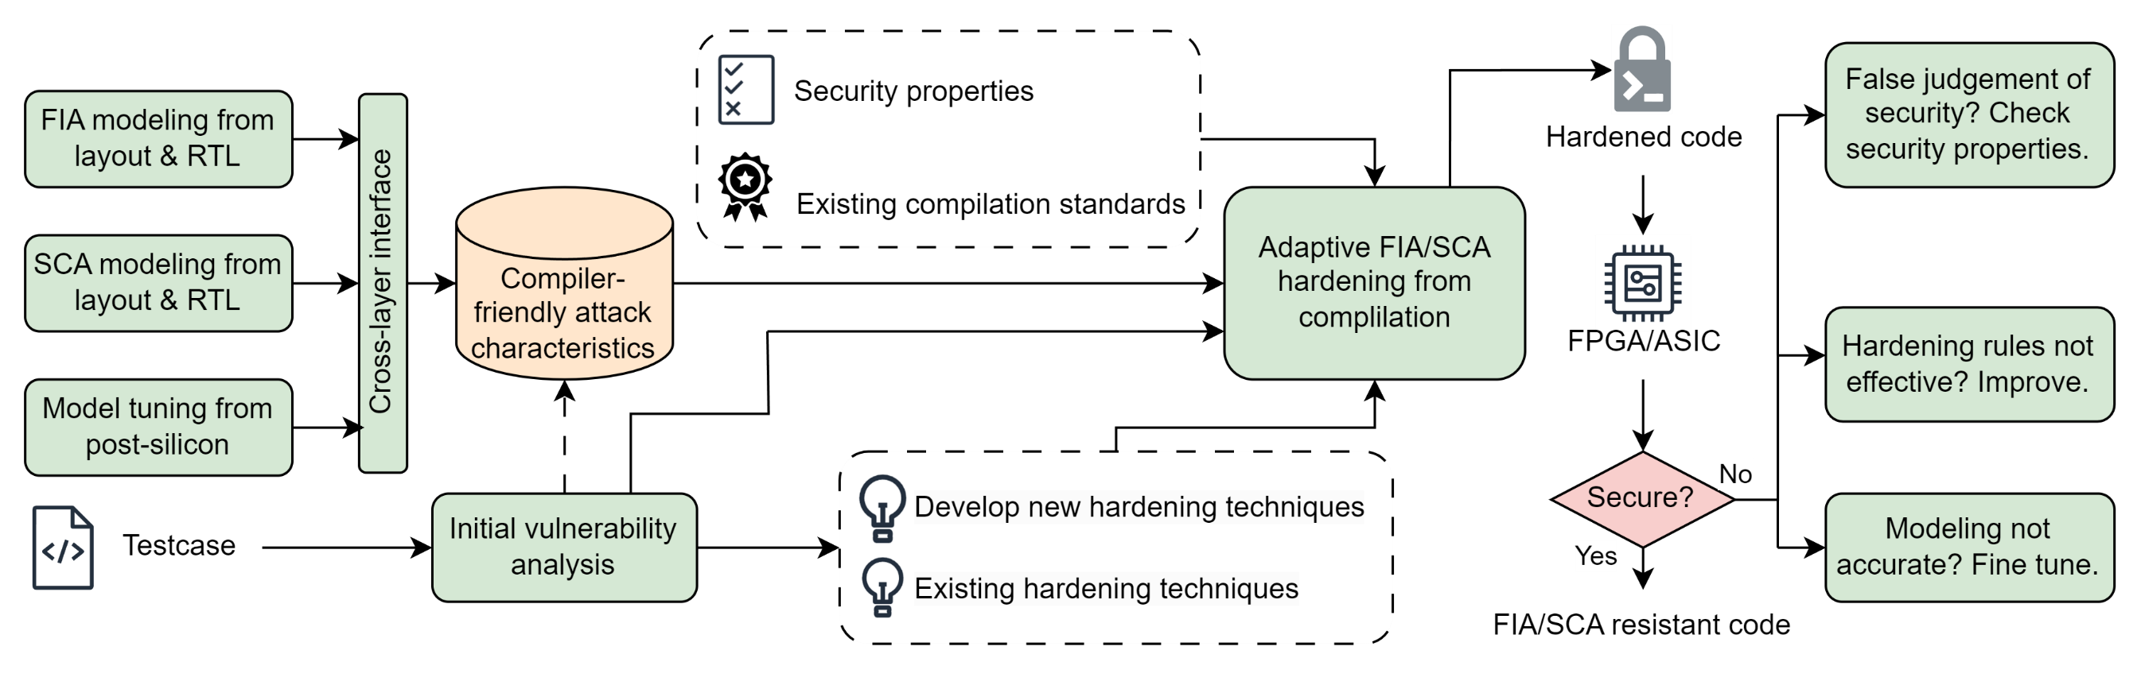
Project Tasks
Task 1: Attack Modeling
Task 2: Compiler Development
Task 3: Evaluation

Slide 4
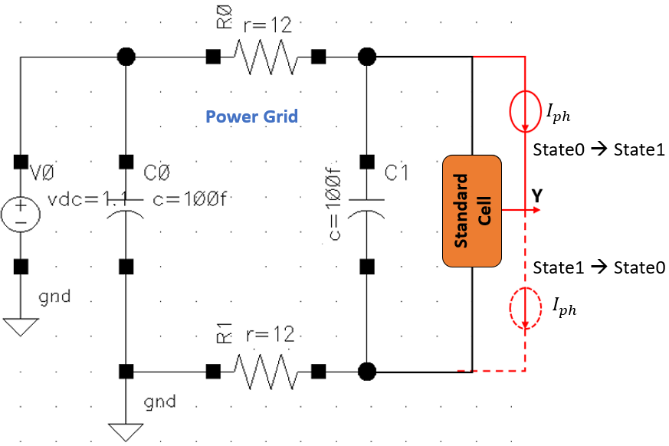


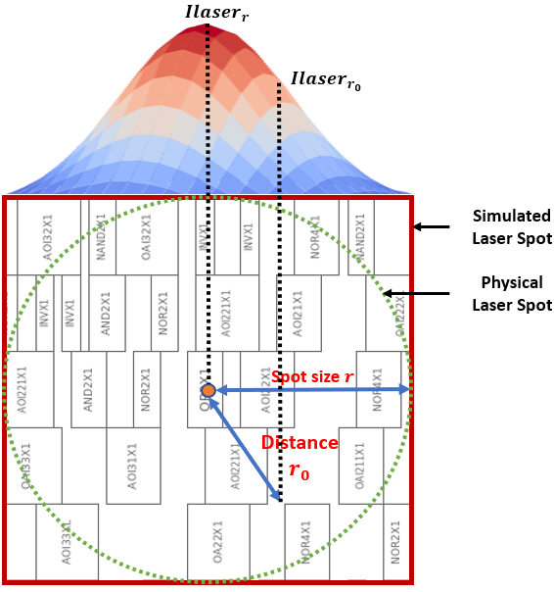
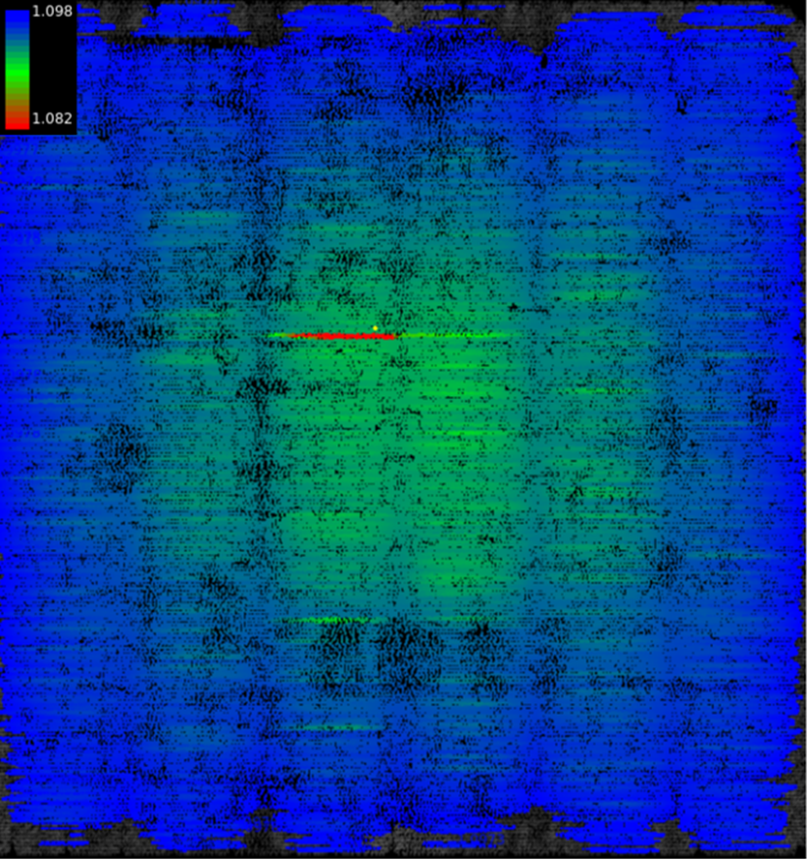
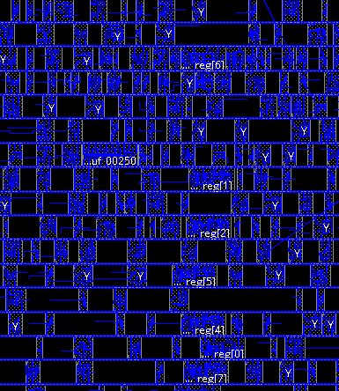
Project Tasks: Fault injection modeling
Laser modeling from layout info (Henian)
Example: laser effect modeled as extra current source in SPICE simulations, then applied in dynamic IR drop simulations (result: built a connection between laser intensity per cell and cell’s accurate current demand)
A weaker but more compatible approach:
Simply calculate or simulate from SPICE for each type of standard cell’s laser induced current
Assume every cell is centered in laser spot (i.e., they got the same laser intensity input, no gaussian distribution)
The outcome is compatible to compiler: a look-up table. Input the laser intensity and cell type, get the laser-impacted current demand
Repeat for all type of standard cells
Voltage drop simulation on the layout
Substitute impacted cells’ current
response with laser-impacted version

Slide 5
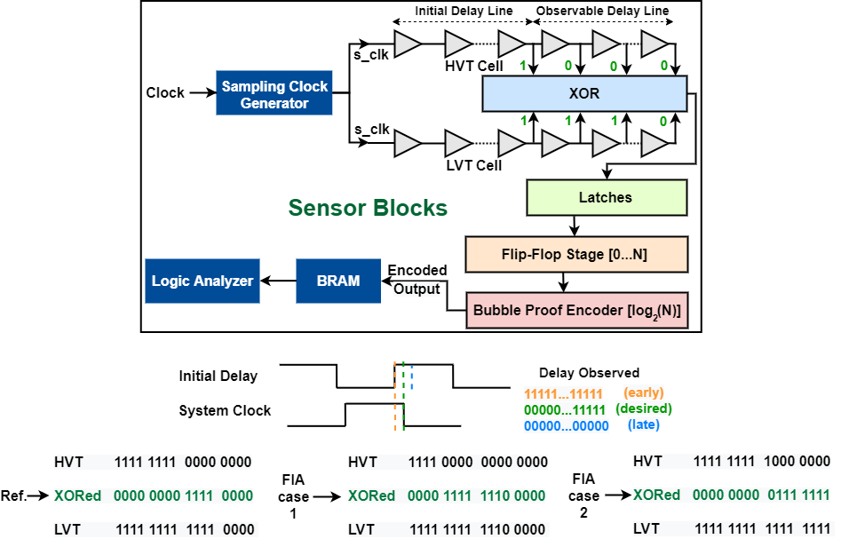
Project Tasks: Fault injection modeling
Explore applying similar approach on other optical fault-injections (flashlight, UV-light, etc.)
Clock/voltage glitch modeling from layout info (Habib)
Discussed with Habib about thinking of modeling the timing effects
Possibility of quantifying the delay change caused by glitching and model the connections
Modeling from post-silicon findings (Pantha)
Validate the layout level modeling when a finer model is desired

Slide 6
Project Tasks: Compiler Development
Test case and security properties (Henian)
Aims for C/C++ -> Assembly code compilation and hardening
Plan to start with firmware, AES software, password checking, etc.
Develop corresponding security properties, requiring a good literature review
Modeling-compiler interact (Henian & Arun)
Compiler must provide:
A configurable “hardening level” input to determine the input (e.g., laser intensities) for FIA models
A simple mechanism to determine target instructions (e.g., directly extract sensitive instructions from security properties; or through static code analysis.)
Translation from target instructions to actual instances/area, which serves as final input for models
Compiler must receive:
Feedback from modeling in a compatible form of either 1) a threat level / a vulnerability ranking of inputted sensitive instances, or 2) a simple secure-or-not judgements from modeling under certain parameter inputs
Reference: Gangolli, A.; Mahmoud, Q.H.; Azim, A. A Systematic Review of Fault Injection Attacks on IoT Systems. Electronics 2022, 11, 2023.
Reference: Höller A, Krieg A, Rauter T, et al. Qemu-based fault injection for a system-level analysis of software countermeasures against fault attacks[C]//2015 Euromicro Conference on Digital System Design. IEEE, 2015: 530-533.

Slide 7
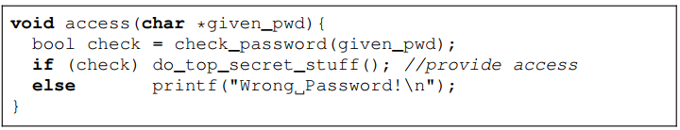
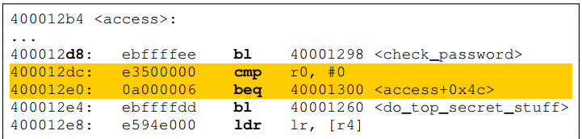
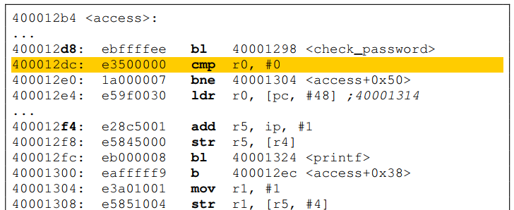
Project Tasks: Compiler Development
Hardening rules database (Arun)
Goal: address the physical faults during the compilation process
Review existing hardening approaches
Utilize or imitate existing solutions in RISC-V GNU compiler
Develop adaptive approach to apply countermeasures using the info (e.g., vulnerability ranking) given by modeling output
Deliverables
Encapsulated implementation of hardening compiler
Proper documentations
Compile
Harden
What happened?
Faults modifying/bypassing the conditional jump will now directly lead to a password-checking failure

Slide 8
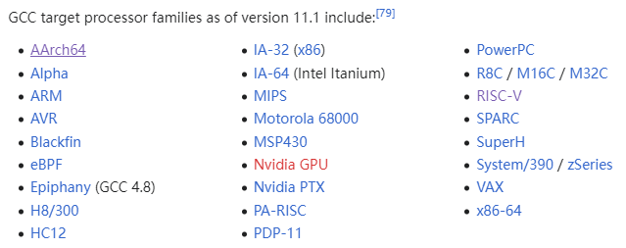
Targeting GCC Plug-ins
GCC (GNU Compiler Collection) is one of the biggest free programs in existence
Supporting many languages (C, C++, Objective-C, Fortran, etc.)
Supporting more target ISAs than any other compiler
Free, extendable, great community
GCC allows custom plug-ins
No need to modify GCC source code
Supporting custom analysis, security enhancements
Example
Let’s customize a (weird) feature that has GCC report a warning when detecting ‘PRINTF’ in C codes!
Thanks to ChatGPT

Slide 9

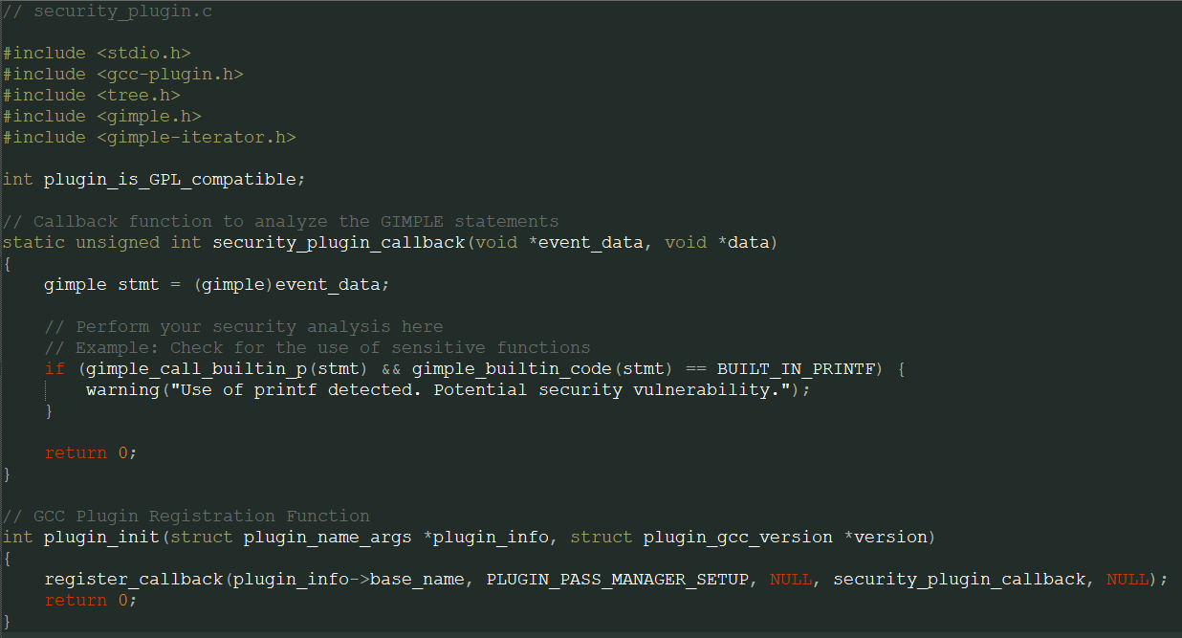
Targeting GCC Plug-ins
GCC (GNU Compiler Collection) is one of the biggest free programs in existence
Supporting many languages (C, C++, Objective-C, Fortran, etc.)
Supporting more target ISAs than any other compiler
Free, extendable, great community
GCC allows custom plug-ins
No need to modify GCC source code
Supporting custom analysis, security enhancements
Example
Let’s customize a (weird) feature that has GCC report a warning when detecting ‘PRINTF’ in C codes!
Thanks to ChatGPT
Create the plug-in code:
Compile the plug-in with GCC itself:
gcc -shared -o security_plugin.so security_plugin.c -fPIC -Wall -Wextra -I /usr/lib/gcc/x86_64-linux-gnu/9/plugin/include
Then, compile the test program with customized plug-in:
gcc -fplugin=./security_plugin.so -c test_program.c

Slide 10
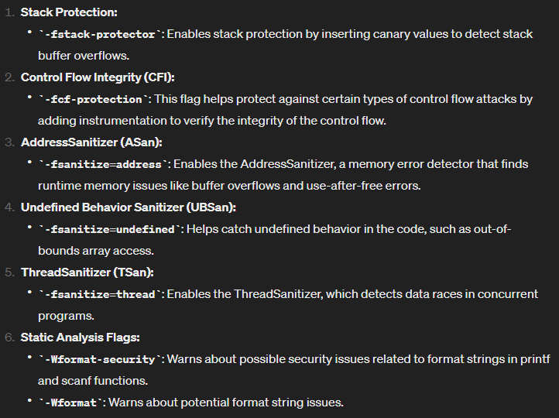
Security Features in GCC and GCC Plug-ins
GCC has built-in security-check options
Checked all of them, none is considering physical attacks
Although some protections may affect physical attack results/efficiency, they are not intended for it
Other great plug-in communities
Provide plug-in tool set with extra security features
So far I found an opensource one, Annobin from Redhat, there are more plug-in tool set
Supporting some hardening rules, and they are extendable
https://developers.redhat.com/blog/2018/02/20/annobin-storing-information-binaries#how_to_build_it
https://sourceware.org/git/annobin.git
Some of the existing security-check flags in gcc.
More in the manual: https://gcc.gnu.org/onlinedocs/gcc-13.2.0/gcc.pdf

Slide 11
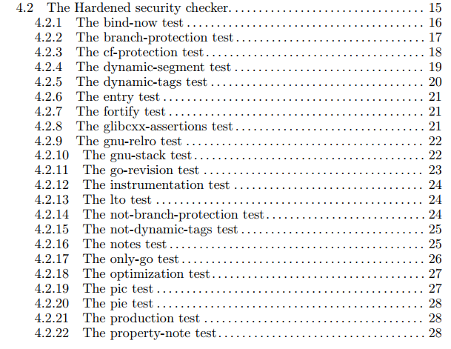
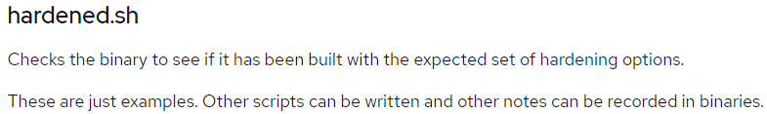
Security Features in GCC and GCC Plug-ins
GCC has built-in security-check options
Checked all of them, none is considering physical attacks
Although some protections may affect physical attack results/efficiency, they are not intended for it
Other great plug-in communities
Provide plug-in tool set with extra security features
So far I found an opensource one, Annobin from Redhat, there are more plug-in tool set
Supporting some hardening rules, and they are extendable
https://developers.redhat.com/blog/2018/02/20/annobin-storing-information-binaries#how_to_build_it
https://sourceware.org/git/annobin.git

Slide 12
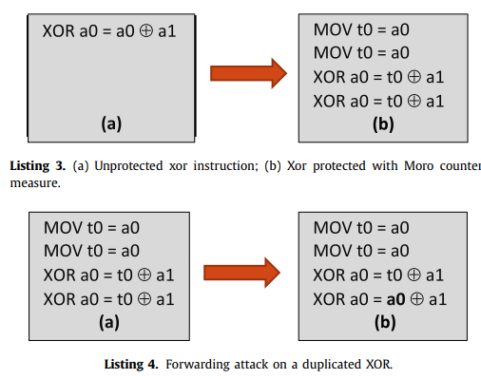
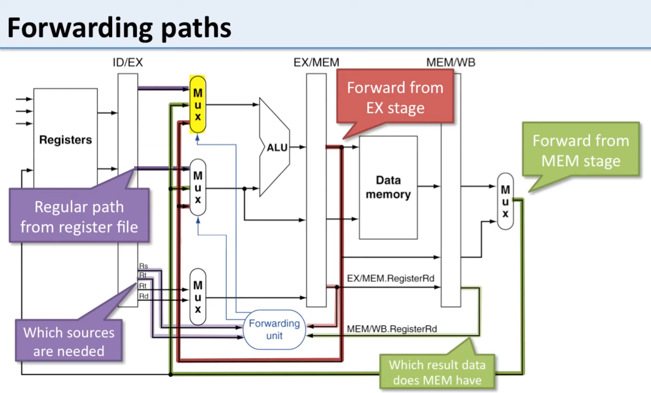
Existing Countermeasures
Duplications as an example
Replace non-idempotent instructions by idempotent ones, then duplicate
Assumed to be resistant against instruction skips, but it’s NOT
Reference: Johan Laurent, Vincent Beroulle, Christophe Deleuze, Florian Pebay-Peyroula, Athanasios Papadimitriou, Cross-layer analysis of software fault models and countermeasures against hardware fault attacks in a RISC-V processor, Microprocessors and Microsystems, Volume 71, 2019
Reference: Forwarding. https://www.youtube.com/watch?v=7n5VY1k8a4o&t=364s

Slide 13
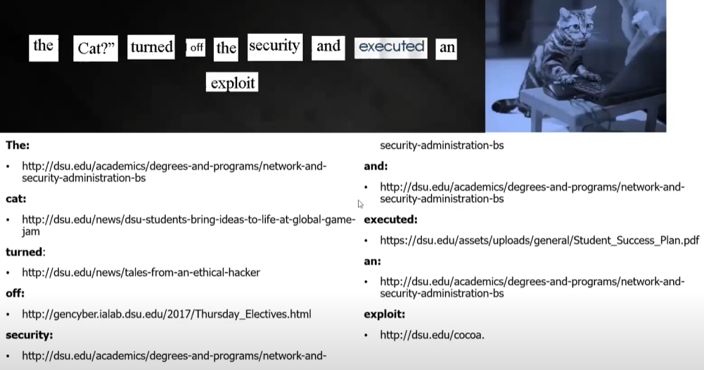
What attacks are existing GCC features targeting?
Return/Jump Oriented Programming (ROP/JOP)
ROP is a well-known cyberattack concerned by existing compilers (GCC, Intel’s, Microsoft’s)
This basic idea of ROP: borrowing chunks (gadgets) everywhere and create something new
Gadgets are snippets of instructions ending with a ‘return’
There are tools available to automatically search and build your own gadget chain
ROP/JOP rely on modifying the return address with stack overflow attack
Does the existing protections on stacks happen to prevent some physical attacks?
Laser or clock/voltage glitch on stack registers? Maybe.
Side-channel or probing? No.

Slide 14
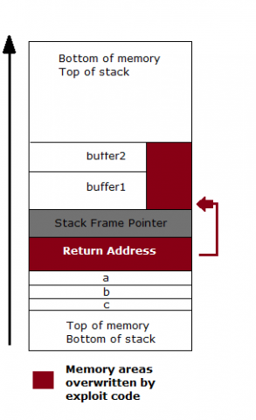
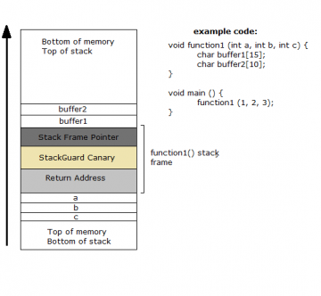
What attacks are existing GCC features targeting?
Return/Jump Oriented Programming (ROP/JOP)
ROP is a well-known cyberattack concerned by existing compilers (GCC, Intel’s, Microsoft’s)
This basic idea of ROP: borrowing chunks (gadgets) everywhere and create something new
Gadgets are snippets of instructions ending with a ‘return’
There are tools available to automatically search and build your own gadget chain
ROP/JOP rely on modifying the return address with stack overflow attack
Insertion of a ‘Canary’ to detect stack overflow
Does the existing protections on stacks happen to prevent some physical attacks?
Laser or clock/voltage glitch on stack registers? Maybe.
Side-channel or probing? No.

Slide 15
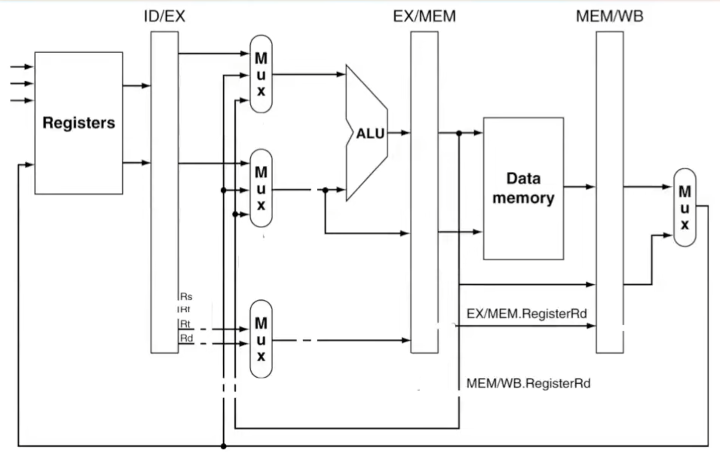
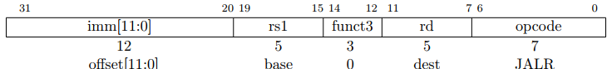
What attacks are existing GCC features targeting?
When we consider physical attacks…
No longer necessary to target stacks (in data memory)
The vulnerable locations that can alter the ‘return’ address in data flow:
Pipeline registers
Register File
Mux, ALUs, etc.
The preserved global value for canary check
Control flow violations
Canary
inserted
JALR (jump and link register) instruction

Slide 16
Thoughts on the Code Hardening
Considering physical model, e.g., laser modeling of standard cells, how to make difference in code hardening?
The key info from modeling is feasibility
In literature, some compilers model physical attacks as bit-flips
Based on my understanding…
Logically eliminating all physical vulnerabilities is costly and impractical
Can we rank the candidate instructions’ safety level when compiling?
(consider their possible cell type, amount of vulnerable sources, hamming distance, existing protections, etc.)
For a certain instruction, can we rank its safety level by its location in code?
Our final outcome can be in the form of a GCC plug-in
It minimizes the vulnerabilities, and leaves the rest only as difficult attack scenarios
Canary
inserted
JALR (jump and link register) instruction

